Slide 1

Hierarchical Layer-Switching Communication for Semantic Negotiation Framework
Notes:
This is our project combining semantic negotiation with distributed reinforcement learning.

Slide 2

Introduction
“Our project focuses on improving multi-agent coordination in the PettingZoo SimpleSpread environment by combining distributed reinforcement learning with a semantic negotiation mechanism inspired by the HLSCSN framework.”

Slide 3
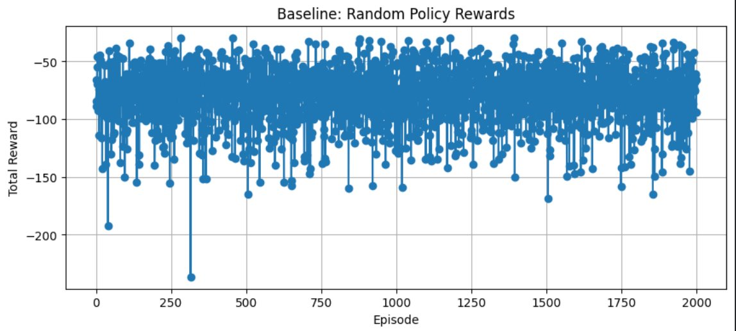
Baseline 1: Random Policy
What is the RB | All 3 agents take completely random actions
Why This Baseline Is Needed | Establishes a ground-zero performance Shows what the environment looks like with pure noise Helps measure improvements
How It Works | 2000 episodes × 50 steps per episode At each step: env.action_space(agent).sample() Sum all agents’ rewards Track total reward per episode Measure timing (total time, avg episode time, step latency)
Expected Results | Rewards are mostly negative High collision rate No progress toward landmarks
Notes:
we run 200 episodes and each episode = a short simulation of 3 agents moving.
Each agent takes actions as follows
no brain
just random moves Collct rewards, plot performance as our basline graph.

Slide 4
Baseline 2: Distributed Heuristic Policy
What Is the Distributed Heuristic Policy?
Each agent shares local direction message
Messages are averaged across all agents
The same action is applied to every agent
No training, no neural networks
Why This Approach?
To introduce basic co-operation without RL
To test whether shared information can improve performance.
To compare communication vs random behavior
How It Works
For each agent, take obs[:2] → the local movement vector
Combine all vectors across agents
Compute the average direction
Convert that direction into one of 5 actions
Apply the same action to all agents

Slide 5
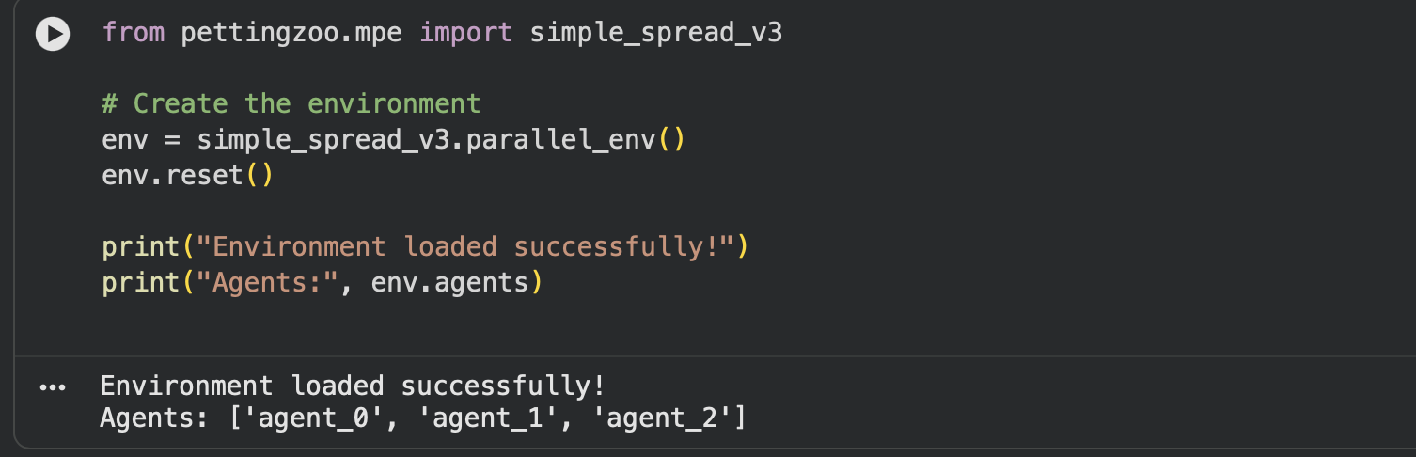
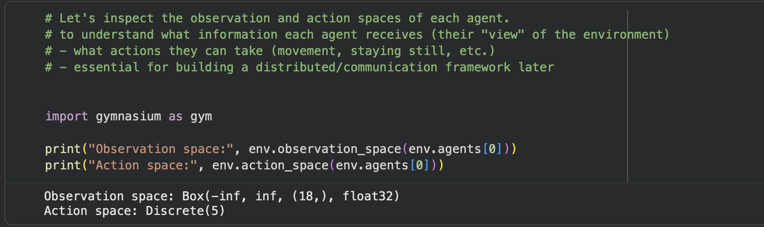
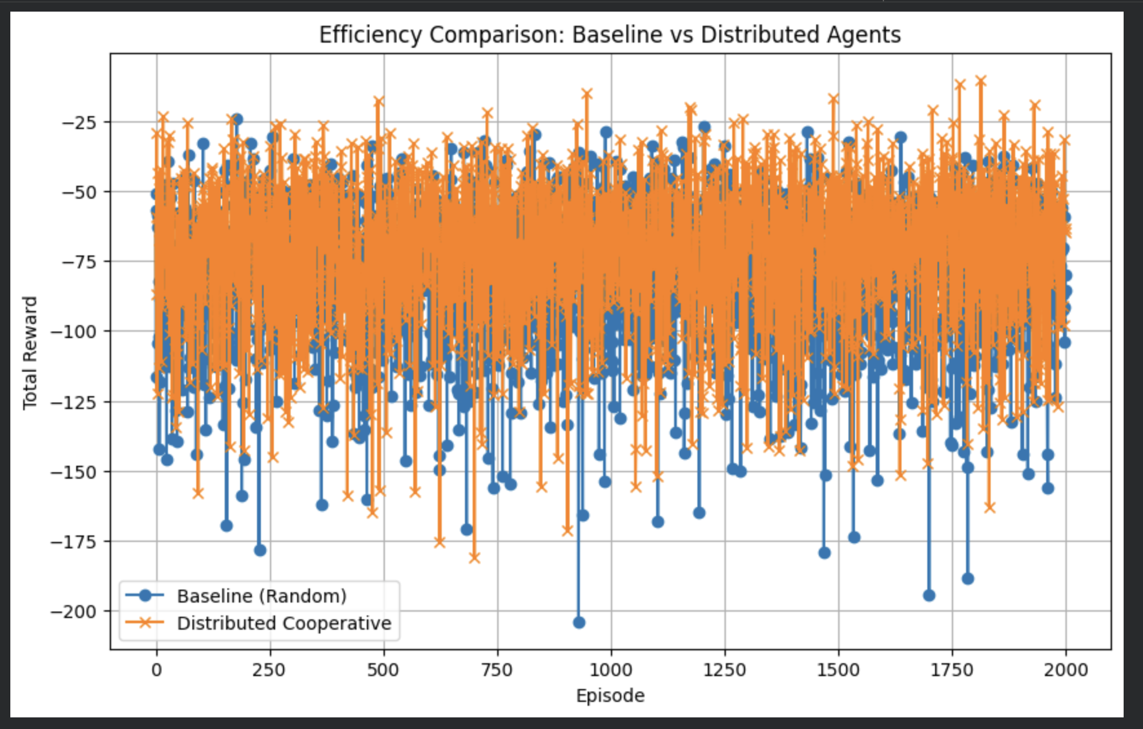
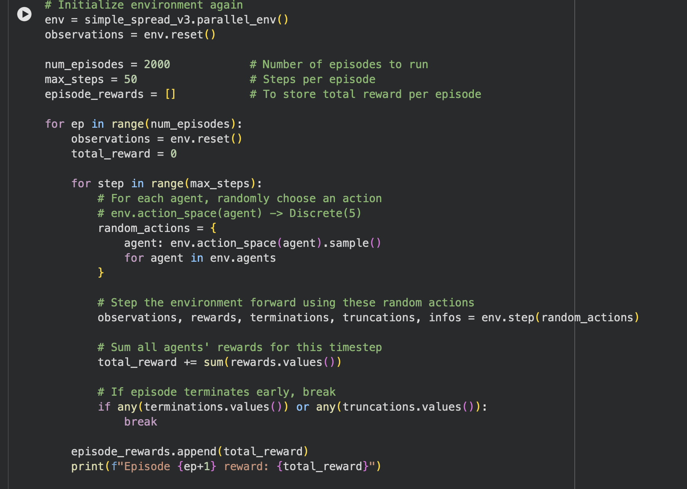
Technical Implementation
https://colab.research.google.com/drive/1UmNpj3-VwC1w2IHUkZRNFv2OL5IXPEUJ?usp=sharing

Slide 6
PPO = Proximal Policy Optimization
What Is PPO?
A policy-gradient RL algorithm
Uses an actor–critic neural network
Learns from agent_0’s observations
Stable-Baselines3 implementation
Why This Approach?
To introduce actual learning beyond heuristics
Tests whether a trained agent performs better than:
Random
Distributed heuristic
Evaluate how learning handles collisions, spreading, and landmark covering
Establish a strong RL baseline before distributed PPO

Slide 7
How It Works
Wrap PettingZoo env → expose only agent_0
Other agents take random actions
PPO learns over 50,000 timesteps
Actor network outputs action for agent_0
Critic network estimates value
Evaluate over 2000 episodes using:
Total reward
Latency per step
Episode time

Slide 8
HLSCSN Semantic Negotiation Framework
What Is Semantic Negotiation?
Agents exchange semantic confidence values
Bayesian updates combine beliefs over cycles
Final output = posterior confidence
Measures meaning alignment, not reward
Runs extremely fast (very low latency)
Why This Approach?
To study how agents align meaning, not just actions
To compare semantics vs reinforcement learning
To introduce a communication layer inspired by HLSCSN
To measure:
Semantic Alignment Rate (SAR)
Posterior confidence
Timing per cycle
To move beyond raw reward → into interpretable agent negotiation

Slide 9
How It Works
Initialize prior confidence for each agent
Exchange short semantic messages each cycle
Update confidence using:
evidence quality
communication reliability
Bayesian fusion
Track:
Alignment success (0/1)
Smoothed SAR
Final posterior confidence
Output timing for semantic negotiation only

Slide 10
Why we needed our own baselines
Existing ones don’t combine distributed coordination + RL + semantics
We needed intermediate steps to move
from random → heuristic → PPO → semantic model
Notes:
Our system uses PettingZoo agents that learn, communicate, update confidence with Bayesian logic, and switch communication layers while running PPO and distributed PPO.”

Slide 11
Environment
A multi-agent coordination environment from PettingZoo (MPE)
Contains 3 agents and 3 landmarks
Agents must cover all landmarks while avoiding collisions
Fully cooperative: all agents share the same reward
[Agent 1] [Landmark A]
[Agent 2] [Landmark B]
[Agent 3] [Landmark C]
Goal: Each agent moves → All landmarks must be covered
Penalties: Collisions or crowding
Notes:
Every agent receives an 18-dimensional vector

Slide 12
Performances
Method | Reward Performance | Step Latency | Key notes
Random Policy | Worse 70-150 | Fastest | No coord, high collision
Distributed Heuristic | Better 40-90 | Very fast | Simple cooperation through shared direction
PPO-1-Agent RL | Higher reward | Slower latency | Agent learns to avoid collisions
Distributed PPO (4-env Parallel) | Best RL reward | Good Latency | Faster learning + better policy stability
HLSCSN Semantic Negotiation | Not focused on reward | Very fast | Improves semantic alignment instead of reward

Slide 13
Challenges & Next steps
We will measure how semantic alignment affects coordination, latency and reward
Improving communication encoding so agents coordinate much better
We want agents to negotiate meaning and uncertainty before selecting actions.

Slide 14
Metrics Used
• Reward Efficiency • Latency (sec/step) • Semantic Alignment Rate (SAR) • Negotiation Events (NE) • Task Continuity Ratio (TCR)

Slide 15
Conclusion
HLSCSN provides a flexible, human-like communication model for autonomous agents.
The three-layer structure enables agents to shift between aligning concepts, clarifying details, and performing actions.
Bayesian reasoning and RL together allow agents to judge when clarification is needed, improving both accuracy and efficiency.
Over time, agents develop adaptive communication habits that maintain task flow while ensuring shared understanding.
This framework supports more cooperative, scalable, and semantically robust multi-agent systems.

Slide 16
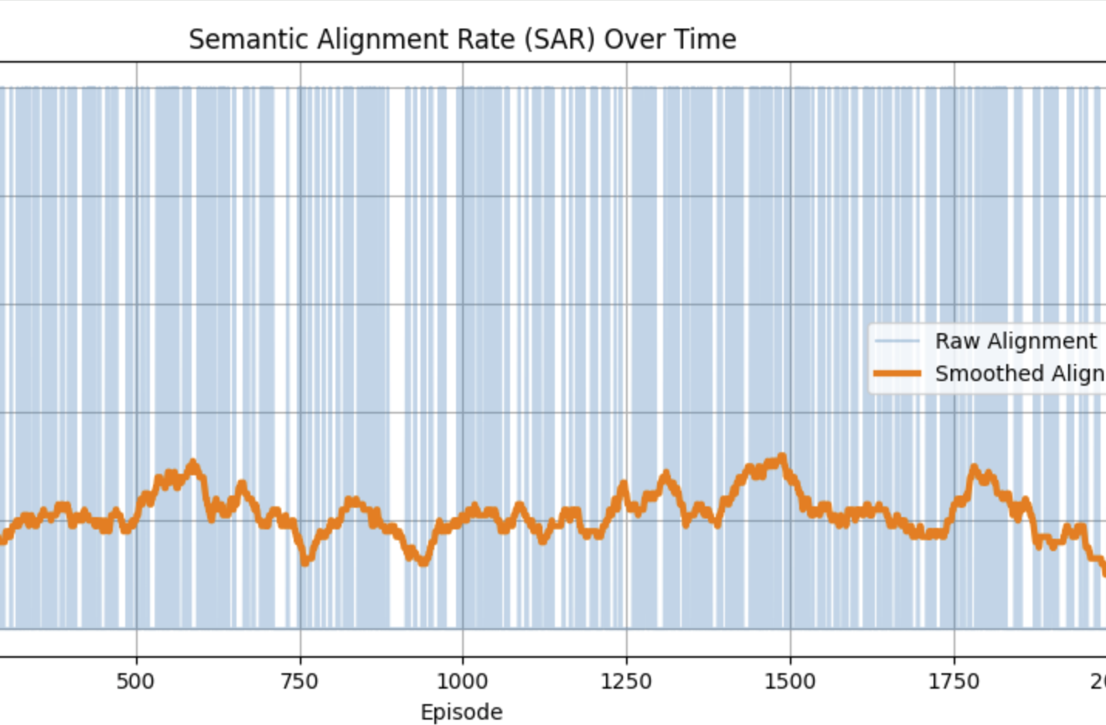
Semantic Alignment Rate
SAR = how often agents understand each other correctly
Blue background = raw alignment (0 = misunderstanding, 1 = agreement)
Orange line = smoothed trend of alignment improving
At first, agents misunderstand a lot
Over time, alignment slowly increases
This proves our negotiation + Bayesian update helps agents learn shared meaning

Slide 17
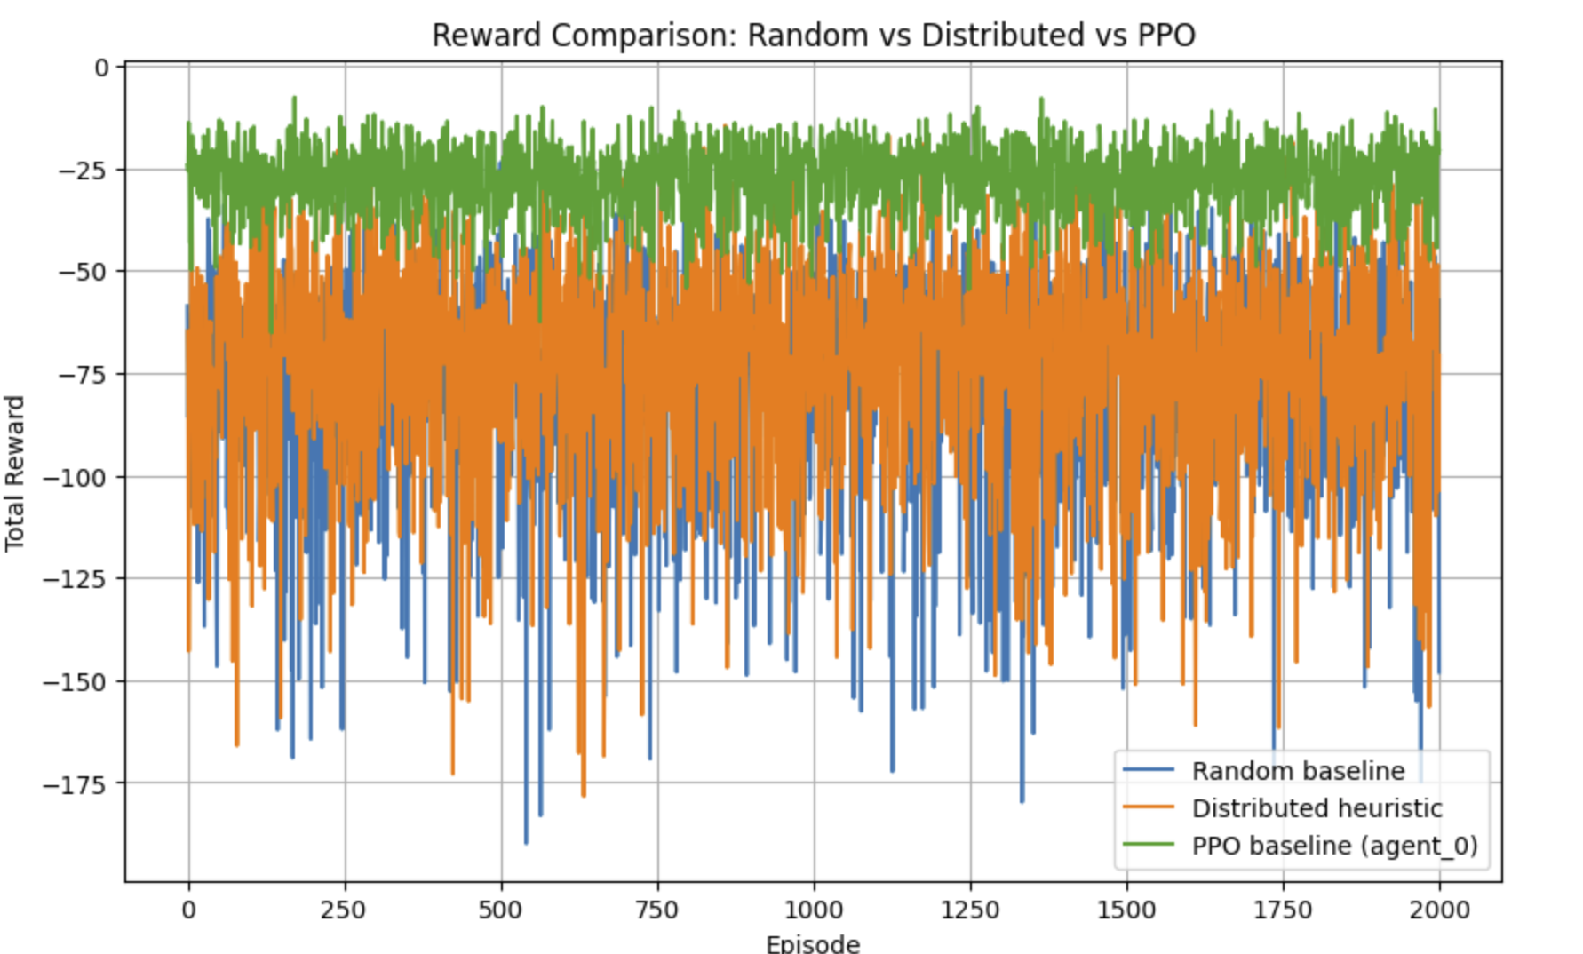
Reward Comparison Graph
PPO gets best reward
DH perform better than Random
PPO more stable learning
Random lowest reward
Learning+commc impr agent behv
PPO learns faster and reaches higher rewards compared to Random and Distributed Heuristic methods.

Slide 18
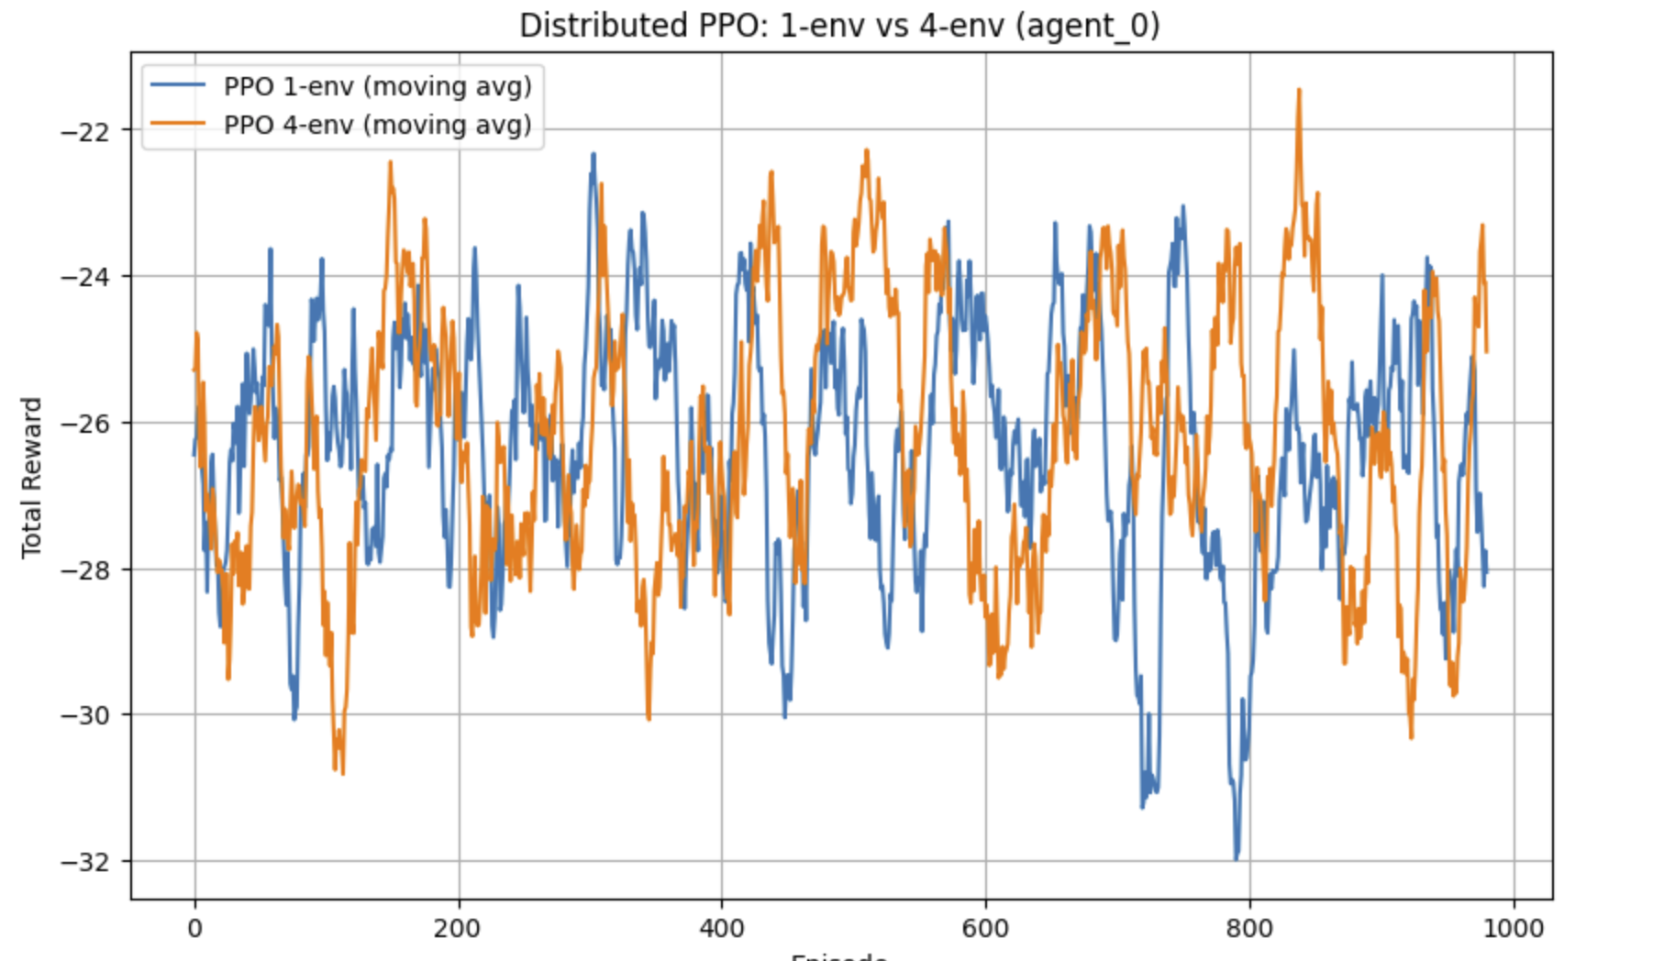
PPO Scaling Graph: 1-env vs 4-env
4-env PPO trains faster
1-env and 4-env has similar rwd lev
4-env PPO has lower latency per step
Shows that distributed training helps speed without hurting performance
-environment PPO provides faster training while maintaining similar reward quality.

Slide 19
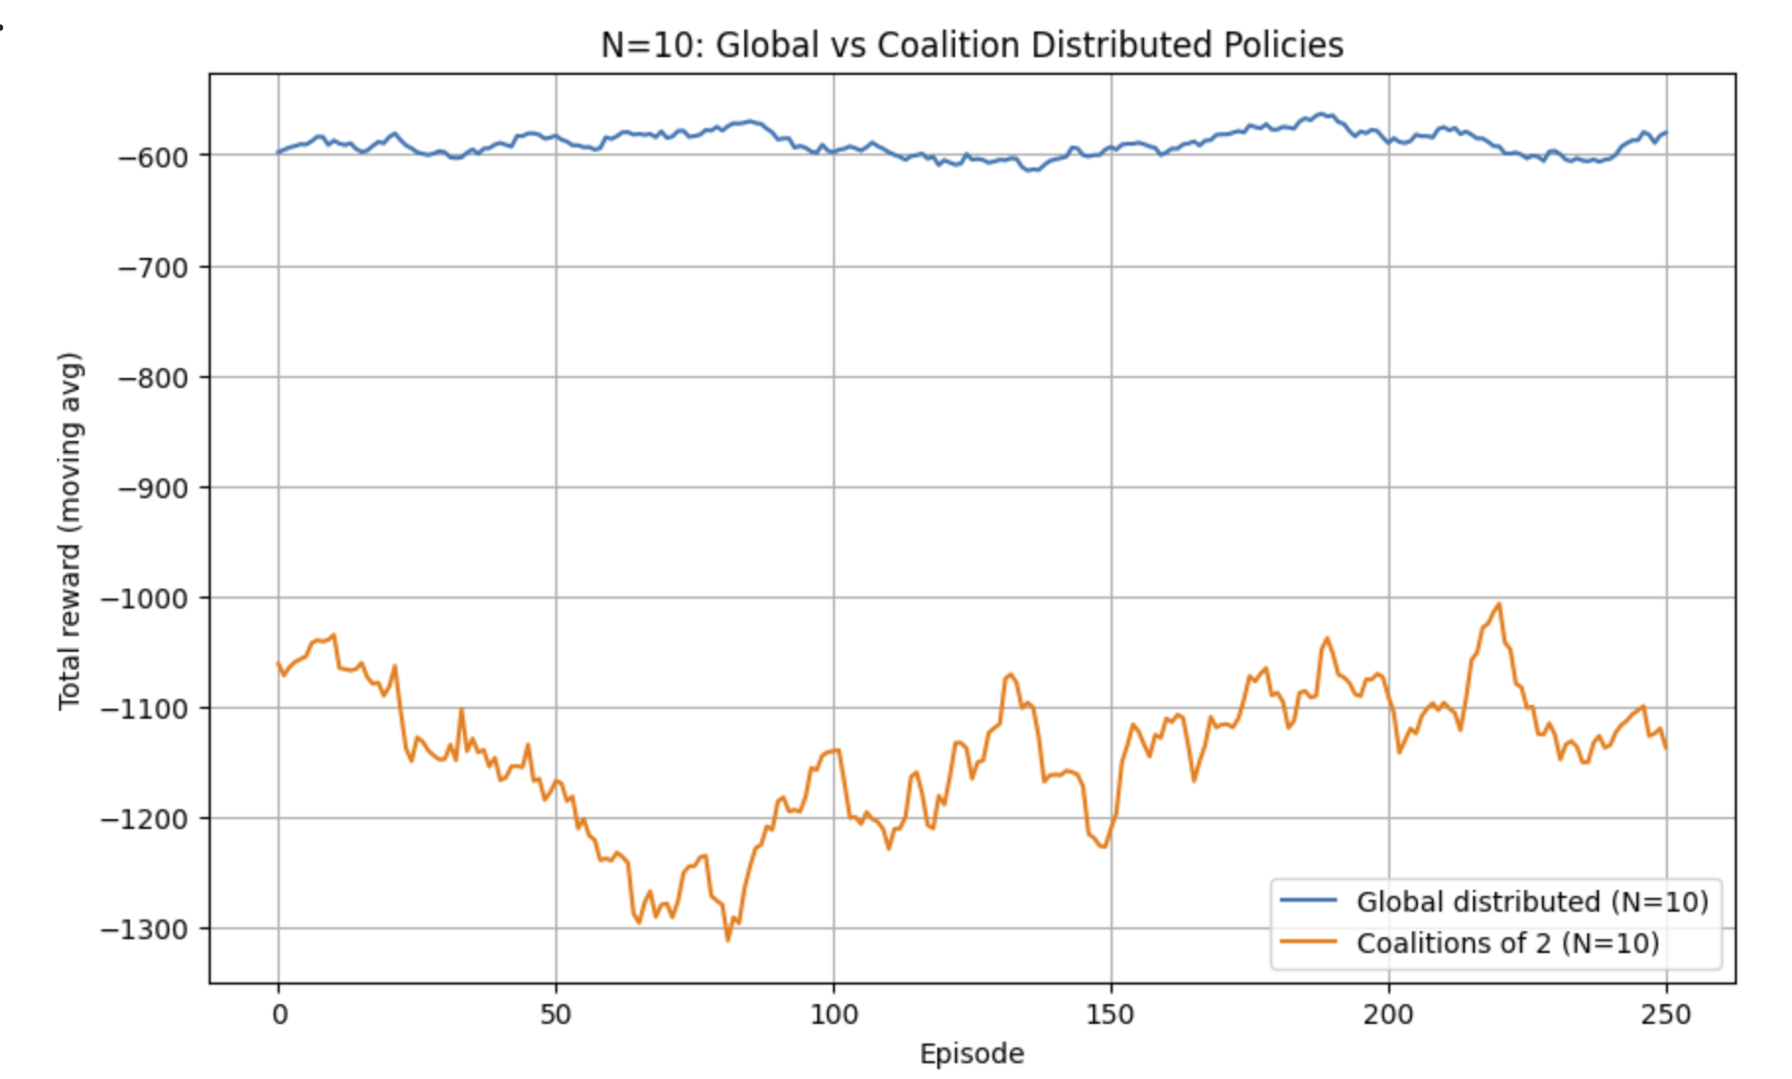
N=10 Global vs Coalition Distributed Policies
Scaling 10 agents global communication perfoms better.
Less communication and small coalitions reward drop hard.
Full knolwdge sharing is very important for teamwork

